Slide 1
Comparison of Classification Models
Shreenidhi Sudhakar

Slide 2
Generative vs Discriminative Model
PGM : Probability Generative Model
Dependent on prior data distribution
Learning each language and then classifying it using the knowledge you just gained
PDM: Probability Discriminative Model
Independent of prior data distribution
Determining the difference in the linguistic models without learning the languages and then classifying the speech.

Slide 3
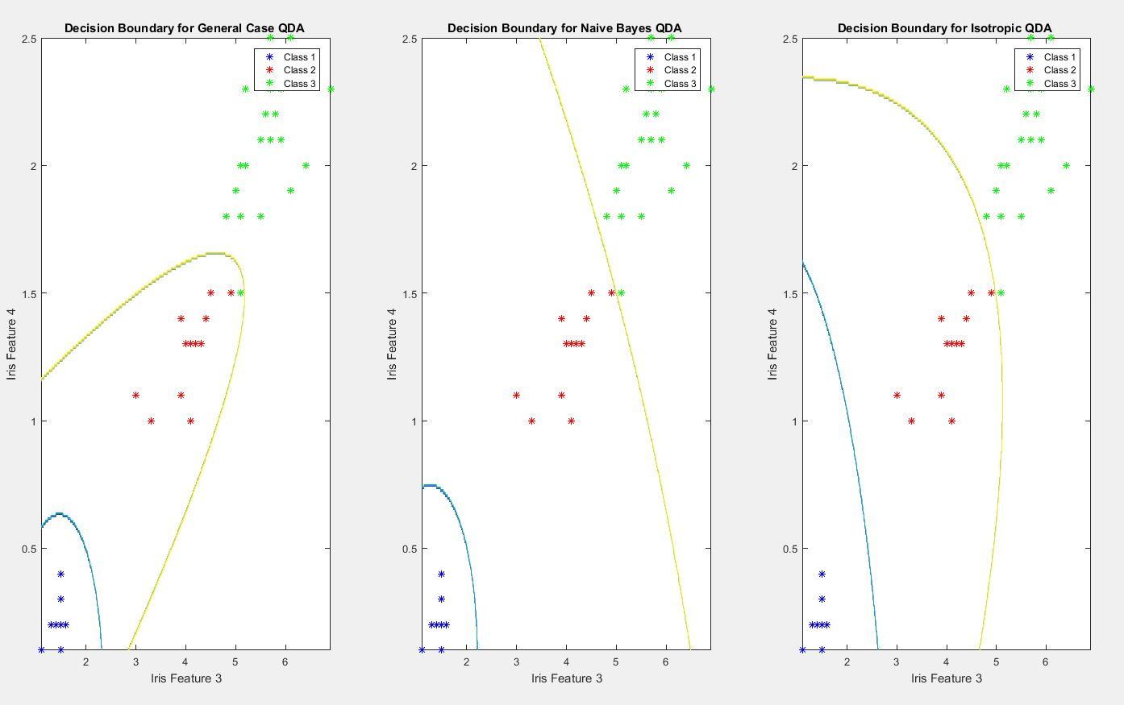
Linear Discrimination Model

Slide 4
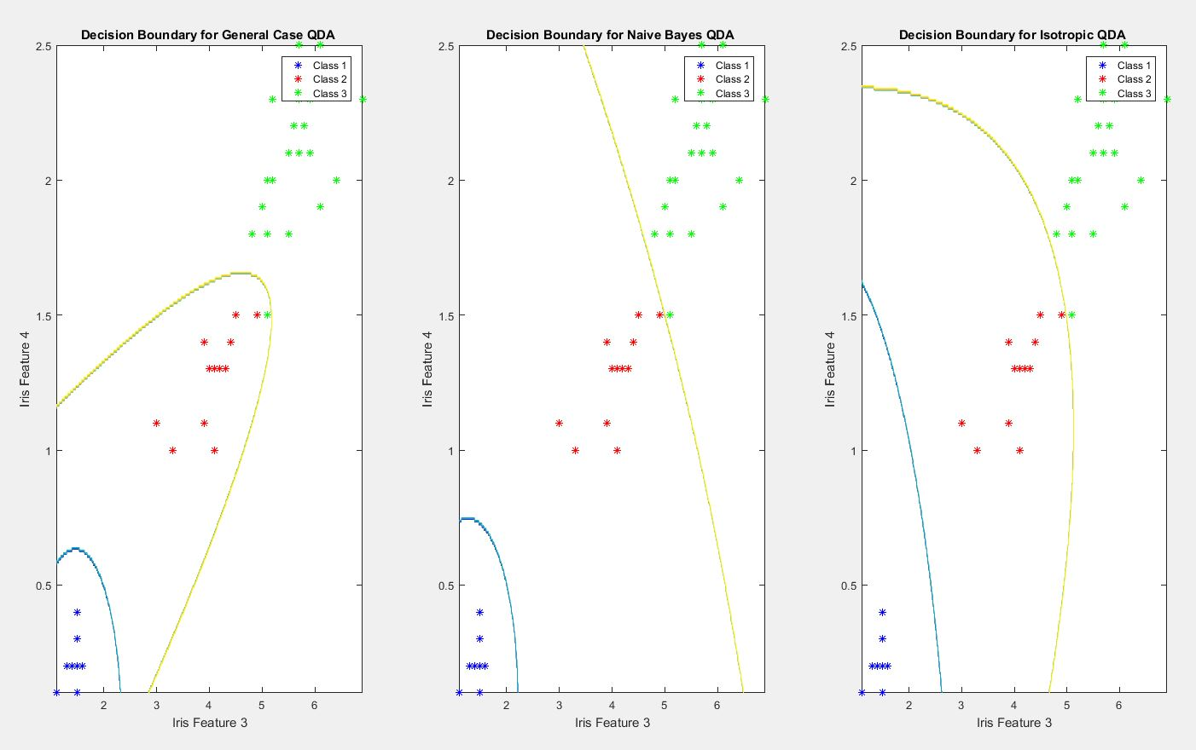
Quadratic Discriminative Model

Slide 5
Results
Linear Discriminative Analysis
Model | Avg LOOC Error | Test Set Error
General | 0.02 | 0.06
Naïve Bayes | 0.00 | 0.05
Isotropic | 0.00 | 0.04
Quadratic Discriminative Analysis
Model | Avg LOOC Error | Test Set Error
General | 0.02 | 0.04
Naïve Bayes | 0.00 | 0.04
Isotropic | 0.00 | 0.04

Slide 6
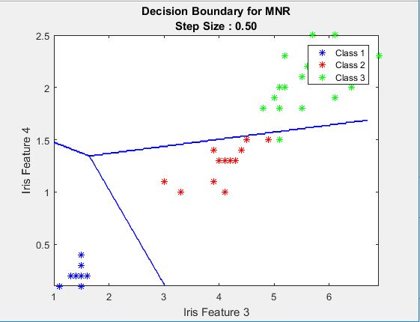
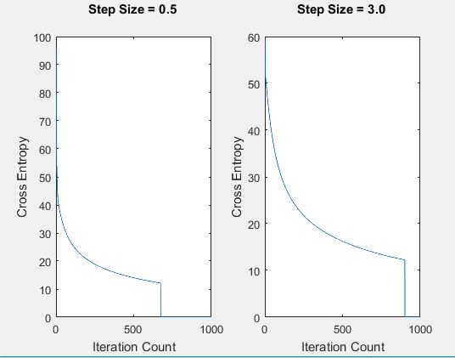
Multinomial Regression Model

Slide 7
Thank You
Check Out: shreenidhi.azurewebsites.net

